Slide 1
DNT Consulting
Team 1:
Vicente Diaz
Khalid Noman
Sadarius Trotter

Slide 2
Project Objectives
Maximize efficiency of the employees
Increase productivity of the staff
Provide alternatives to completing tasks

Slide 3
Project Assumptions
The system should have the ability to integrate with current systems
Staff will be trained and will use the system for its designed purpose
Implementation of the recommendation will not disrupt the business

Slide 4
Requirements Gathering
Observing
Observed current method of invoicing vendors
Recorded steps needed
Analyzed inefficient areas
Interviewing
Interviewed director of operations at Lee Baron
Identified requirements and constraints
Pinpointed areas that need to be worked on

Slide 5
Weighted ranking comparison
Criteria |  | QuickBooks |  | Xero |  | Auto-Hotkey
 | Weight | Rating | Score | Rating | Score | Rating | Score
Requirements
Ease of Use | 25 | 3 | 75 | 4 | 100 | 1 | 25
Report Generation | 15 | 5 | 75 | 3 | 45 | 3 | 45
User Friendliness | 15 | 4 | 60 | 5 | 75 | 1 | 15
 | 55 |  | 210 |  | 220 |  | 85
Constraints
Shopify Integration | 20 | 5 | 100 | 3 | 60 | 4 | 80
Development Costs | 10 | 3 | 30 | 3 | 30 | 5 | 50
Development Time | 10 | 4 | 40 | 3 | 30 | 1 | 10
Number of Users | 3 | 4 | 12 | 2 | 6 | 5 | 15
Vendor Support | 2 | 5 | 10 | 4 | 8 | 1 | 2
 | 45 |  | 192 |  | 134 |  | 157
Total | 100 |  | 402 |  | 354 |  | 242

Slide 6
QuickBooks Options
On Prem
Designed mainly for accountants
Functional but requires a lot of training
Does not prioritize ease of use
Online
Designed for small businesses
Prioritizes ease of use
Uses shortcuts to simplify use
More accessible

Slide 7
QuickBooks Plans
 | Simple Start | Advanced
Price | 30$/month | 200$/month
User Interface | Standard among users | Customizable based on user
Training | Standard training resources | Personalized training at your own pace
Support | Online chat, email, forums | Includes dedicated phone number (24/7)
Reports | Standard reports | Customizable reports

Slide 8
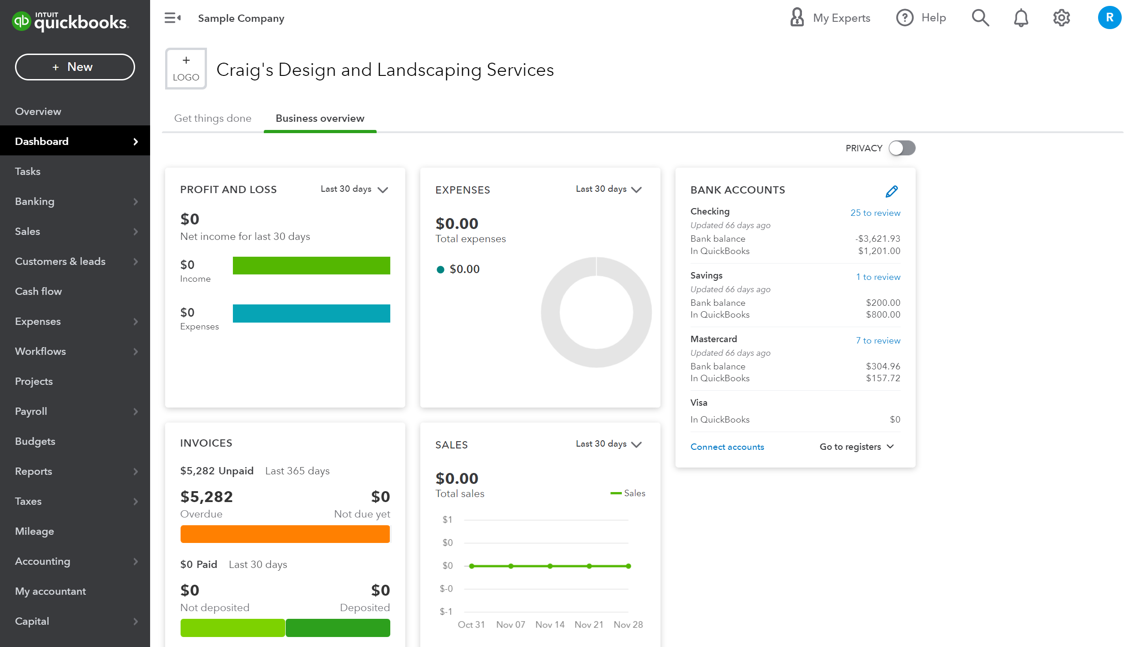
QuickBooks Dashboard

Slide 9
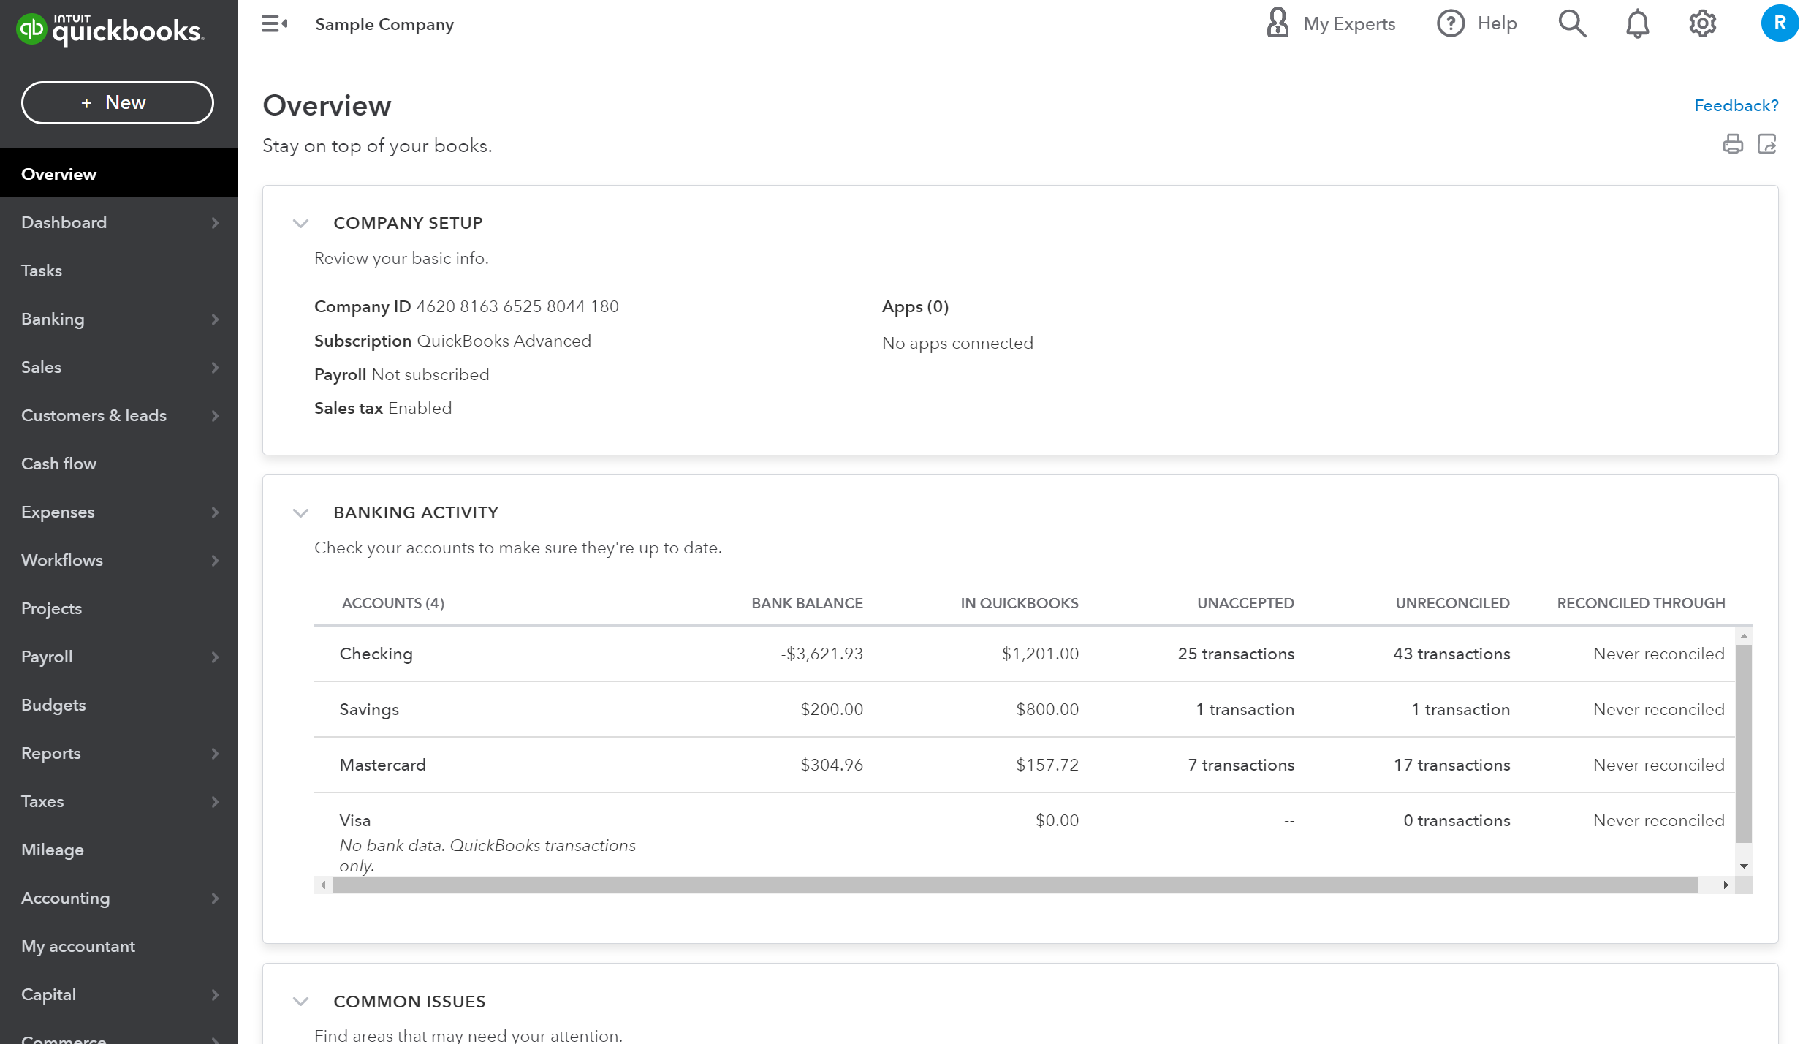
QuickBooks Overview

Slide 10
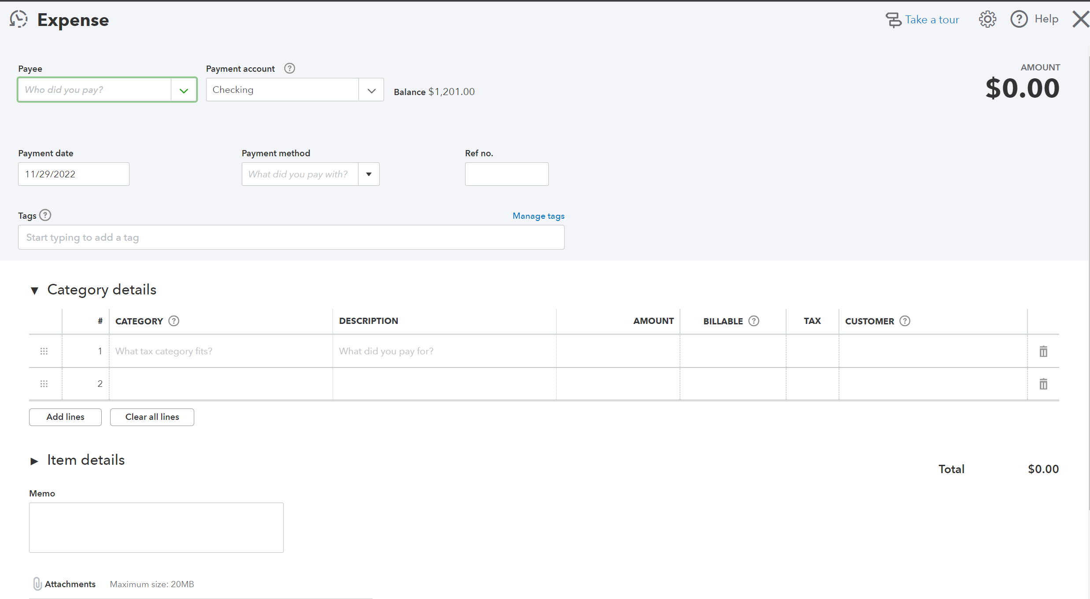
QuickBooks Expense

Slide 11
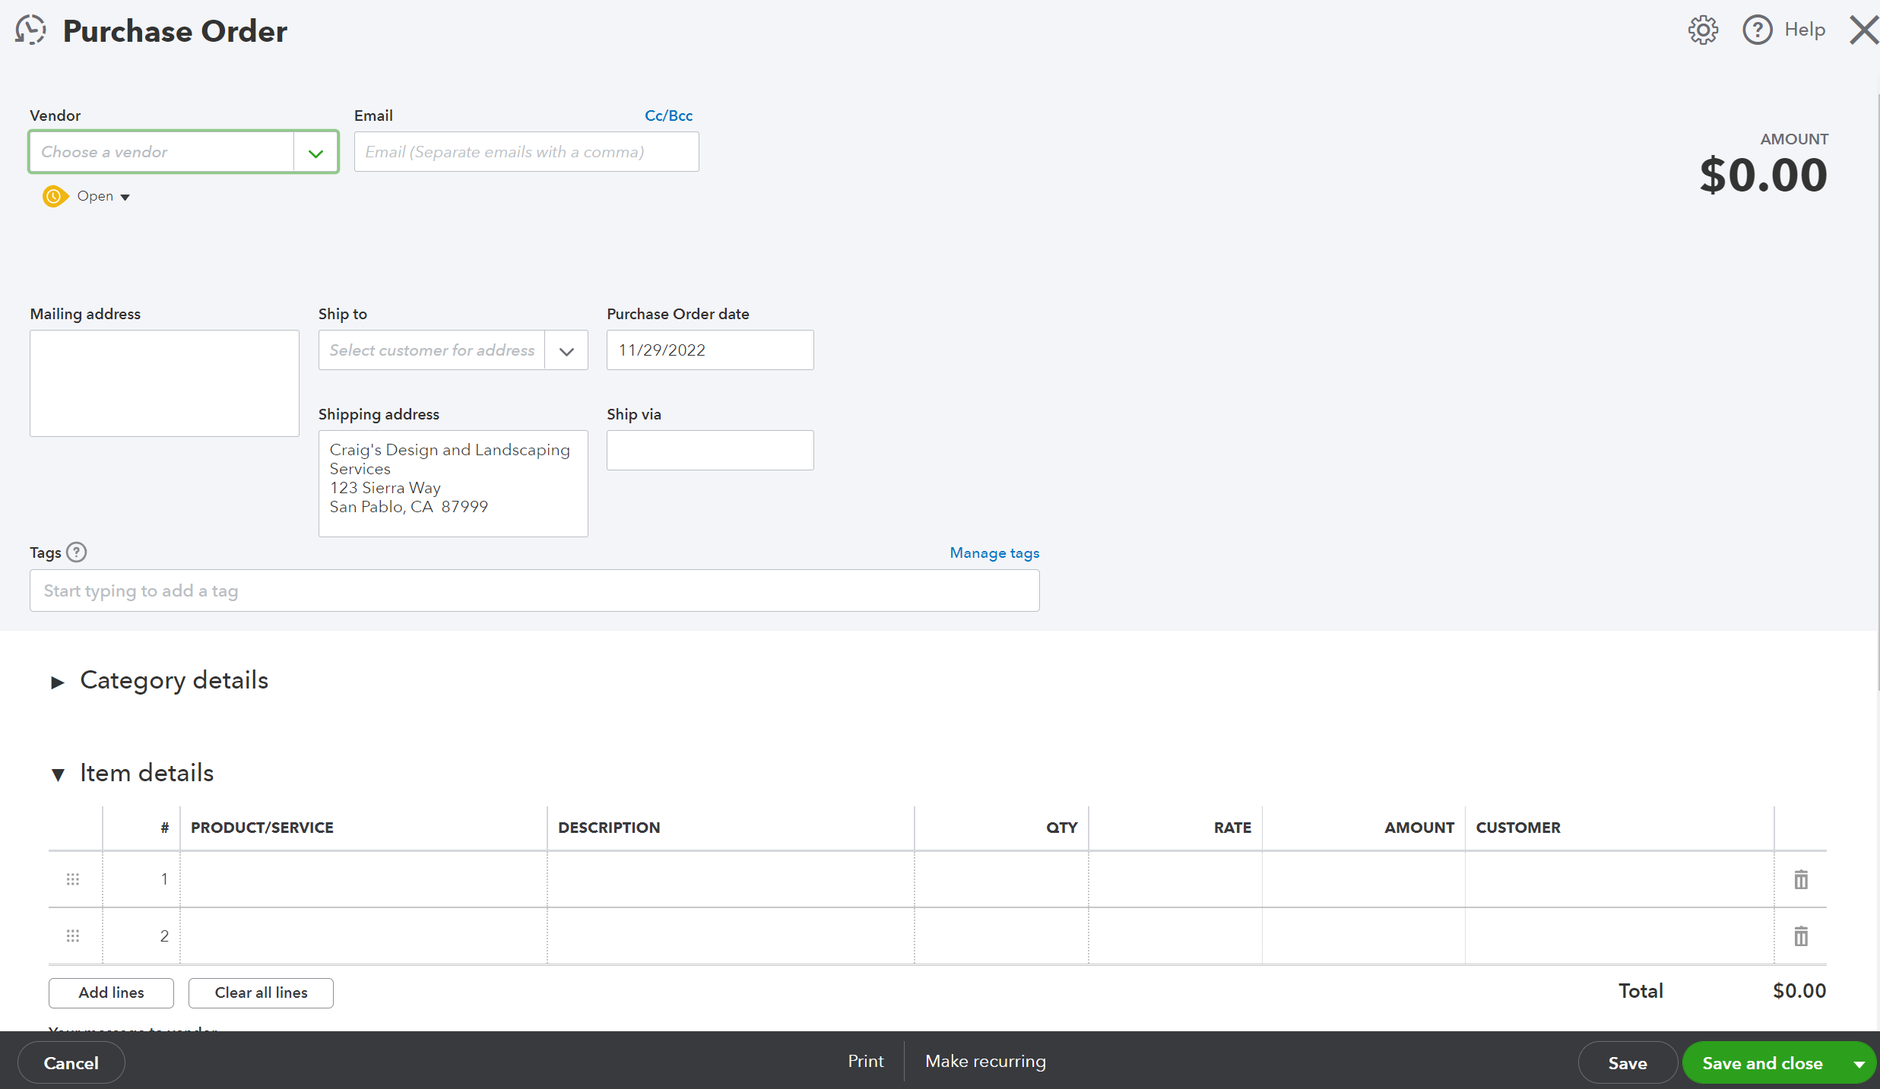
QuickBooks Purchase Order

Slide 12
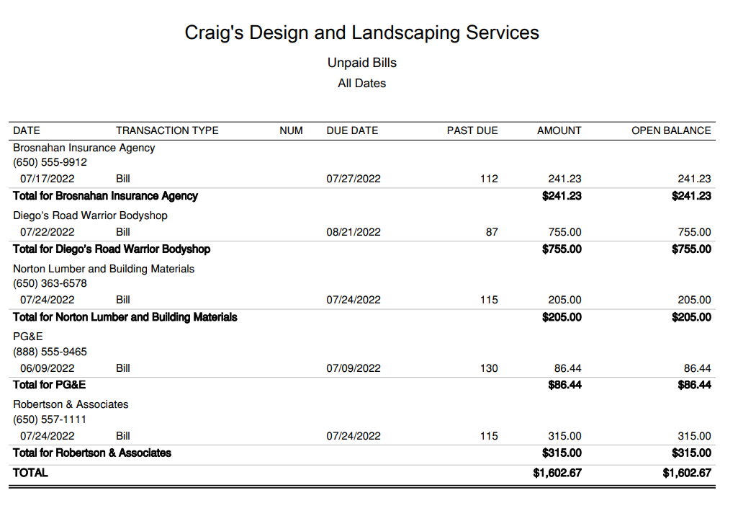
QuickBooks Report

Slide 13
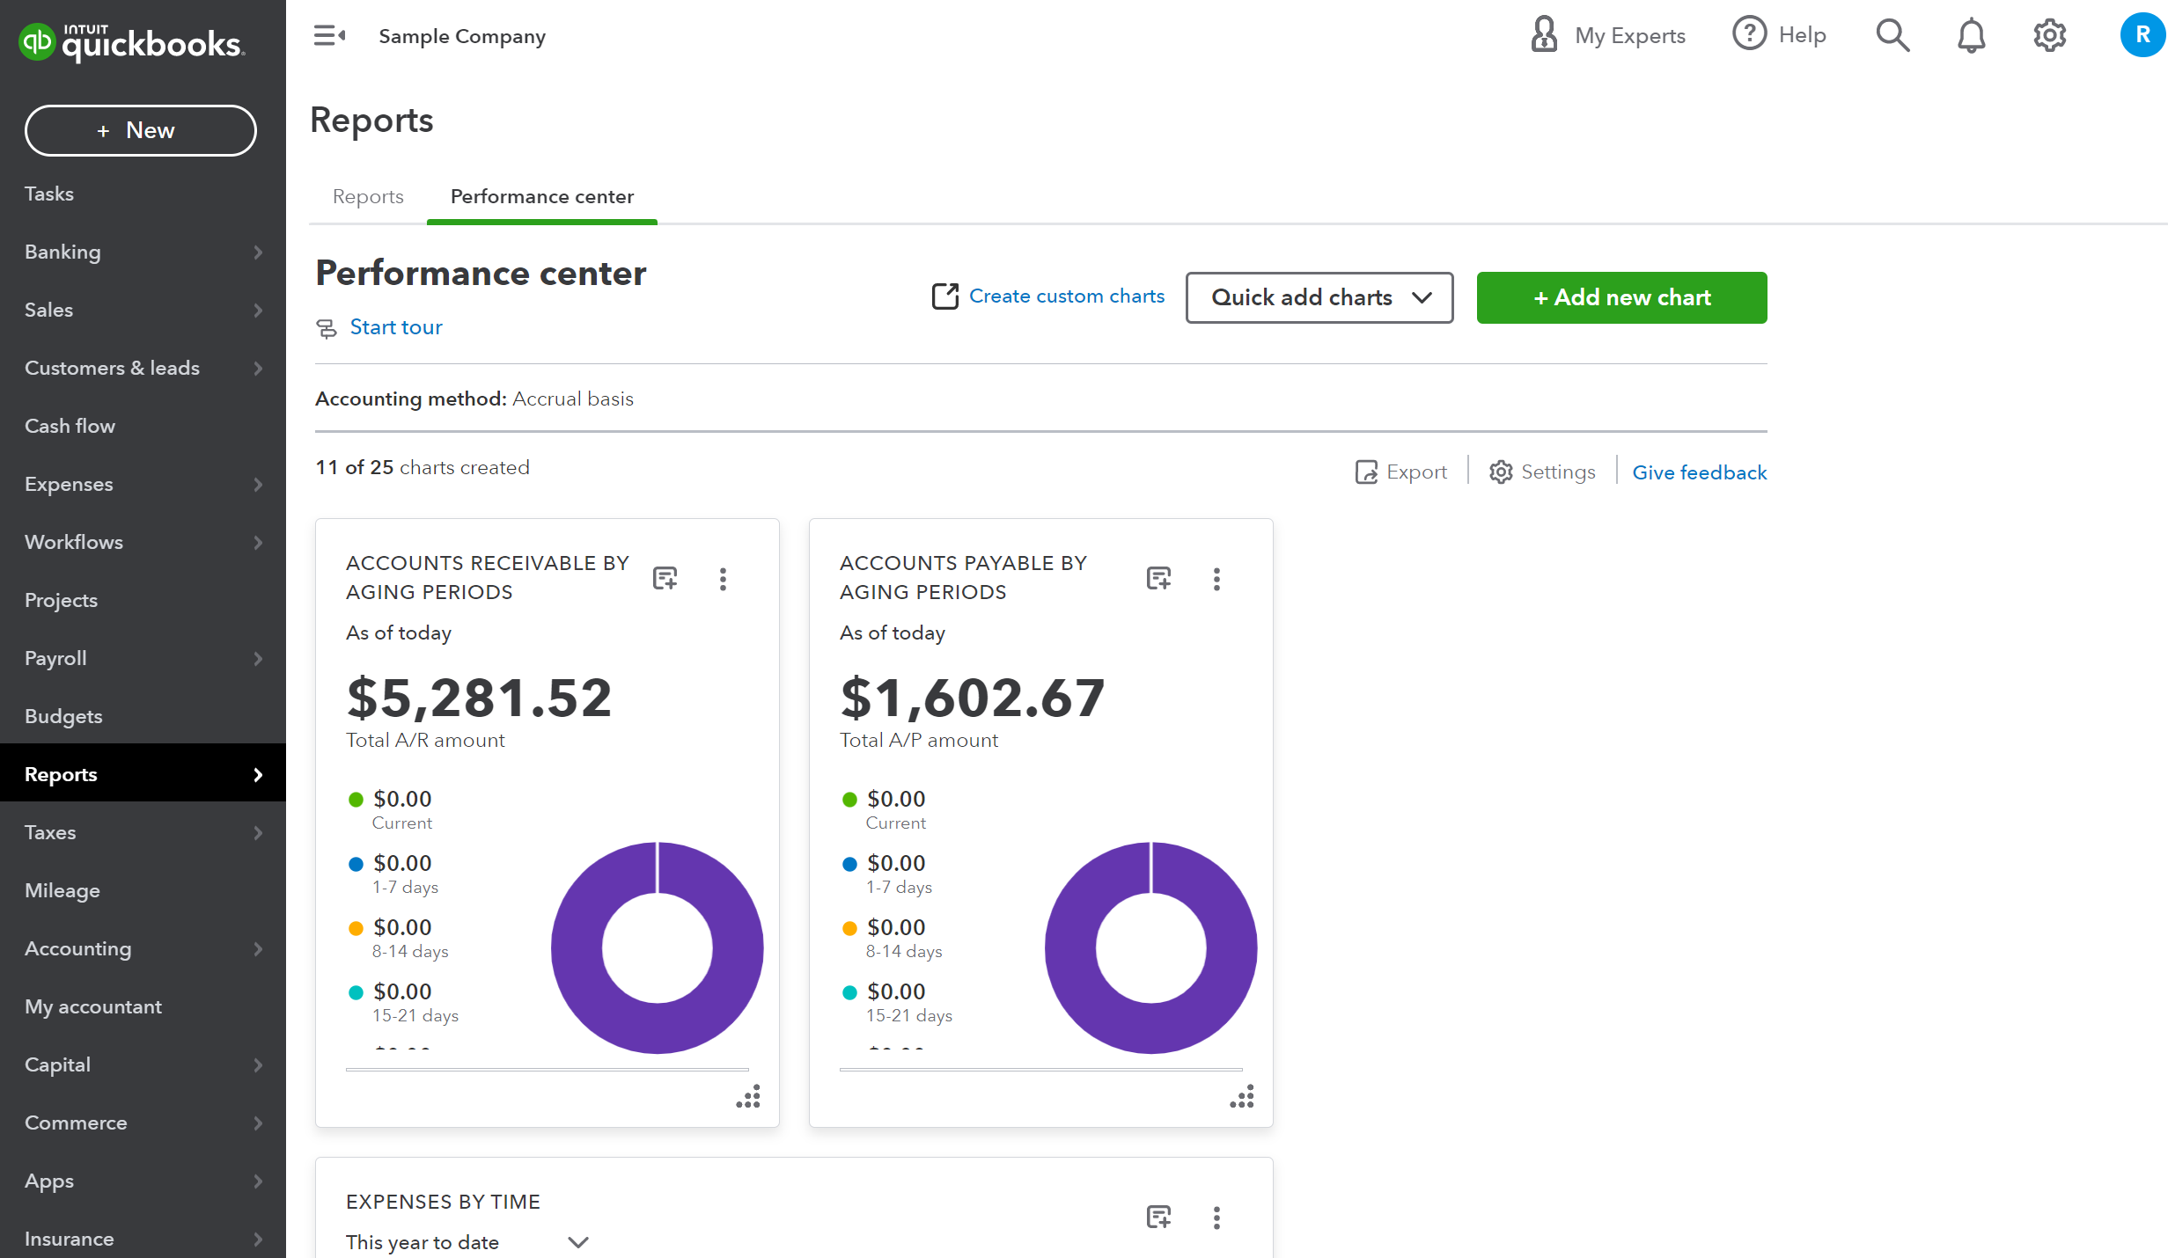
QuickBooks Performance Center

Slide 14
QuickBooks Meeting Highlights
A demo which can be seen in the previous pictures
Predicted price per month of 30$
30-day free trial period
Discount of 50% for the first 3 months
Guarantee of quick and seamless integration with Shopify
Dedicated sales representative to facilitate installation

Slide 15
QuickBooks Online
Short description
Accounting software made by Intuit with a main focus on ease of use and user experience
Main advantages
Ease of use
Seamless integration
Price
30$/month on simple start plan
Discount
50% off on first 3 months
Addons
Setup and training can be added on to plan for one time fee of 50$

Slide 16
Payback
General Benefits
Streamline and speed up invoicing tasks
Accurate information about vendor invoices will be displayed in an easy-to-read fashion
Notifications of upcoming invoice due dates
Monetary benefits
An invoicing clerk’s salary is estimated around $40,000/year
Time will be saved for the director of operations

Slide 17
Cutover method
Parallel cutover
Both systems will be used at first
Old system will be used till staff is confident with the new system
Advantages
Old system can still be used as needed
Staff can train without worry
Business operations remain uninterrupted

Slide 18
Maintenance/Modification
Maintenance
QuickBooks online is accessed through a browser and will not need to be maintained
If issues arise QuickBooks can be reached through the QuickBooks contact webpage or a support number
Modification
The simple start plan does not allow for modification
The plan can be upgraded at any time if it suits the business needs in the future

Slide 19
Training
QuickBooks online is similar to Shopify which many of the staff are familiar with
Training solutions
Local QuickBooks expert: rates vary
Instructor-led classes: from $389.95
Self-paced learning: from $39.95
QuickBooks Training:-
Training videos: Free
Training addon: 50$

Slide 20
Questions?
Development Cost
$30/month
estimated $50 training
Development Time
1-day setup time
5-day training time
Expected Payback
1-month
through time and wages saved

